Slide 1

MIT COVID19 Challenge Datathon
Team_e_10 Kruti Shah,
Julio Elias
Sep Sabeti

Slide 2
Research Question
Health inequalities – associated with poverty, inequality and social determinants of health create conditions to further the transmission of infectious diseases.
Do the underlying geographic disparities - health inequality exacerbate the severity of the COVID-19, hospitalization, and deaths?
What the data tell us? Health inequalities and the pattern of COVID-19
The intuition is that the severity of the pandemic reflect geographic mirrors economic and social disparities across NYC!
Exposure to COVID-19, geography and health outcomes can be analyzed under the framework proposed by Quinn & Kumar, 2014
..

Slide 3
Data Collection
Extracted data for COVID 19 cases as per the zipcode/boroughs of NYC.
https://www.nytimes.com/interactive/2020/nyregion/new-york-city-coronavirus-cases.html#zipcode
Case Count, Hospitalized Count and Death Count on a particular date, by age and by sex. Downloaded this data from
https://github.com/nychealth/coronavirus-data
Identified Demographic data for NYC regarding Age, Sex, Race, Education.
https://data.census.gov/cedsci/table?d=ACS%205-Year%20Estimates%20Data%20Profiles&table=DP05&tid=ACSDP5Y2018.DP05&hidePreview=true
Looking for median-income data by zipcode for NYC.
Labor force profiles – occupational distribution; wages and earnings, health insurance, overall poverty levels; hospitalizations related to flu, asthma, pneumonia and other pre-conditions (by geography, race…), health insurance coverage; air pollution, and commuting patterns (% of workers)

Slide 4
Data Wrangling
Mine data for total count, hospitalized count and death count by visiting history data tab, append in the same file. This will give a time series data.
Map Age and Sex count in each zipcodes to the COVID19 dataset with zipcodes.

Slide 5
Data Analysis
Analyze the trend of the total case count over the period of 2 months data.
Analyze the impact of COVID19 in various zip codes, also analyze the location in terms of which demographic cohort most impacted . Also, analyze the mortality rate due to COVID19 in males vs. females.
Analyze which strata of population got impacted most by COVID19

Slide 6
Data Visualization
Plot
Plot a map giving the number of counts in each zipcode of NYC
Plot
Plot countplot to show the impact on the different age groups, sex etc.
Plot
Plot other suitable graphs to depict the insights of the data.

Slide 7
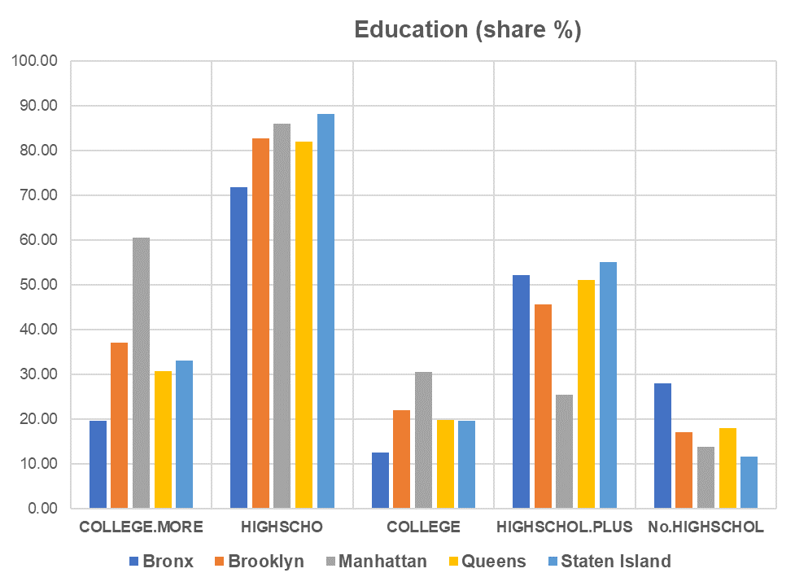
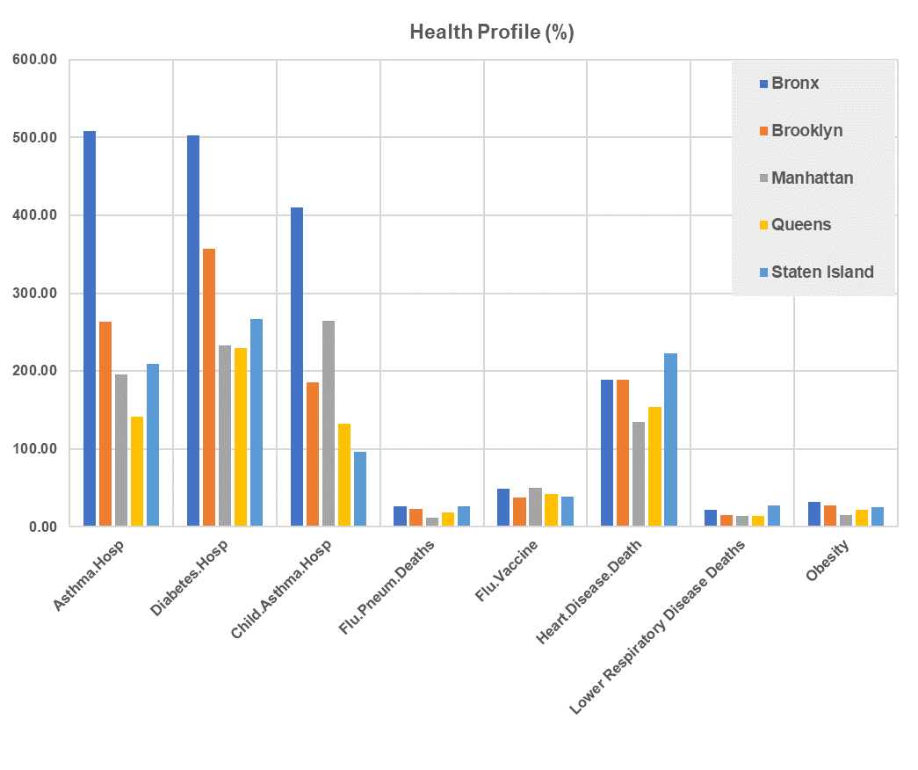
…preliminary data snapshot

Slide 8
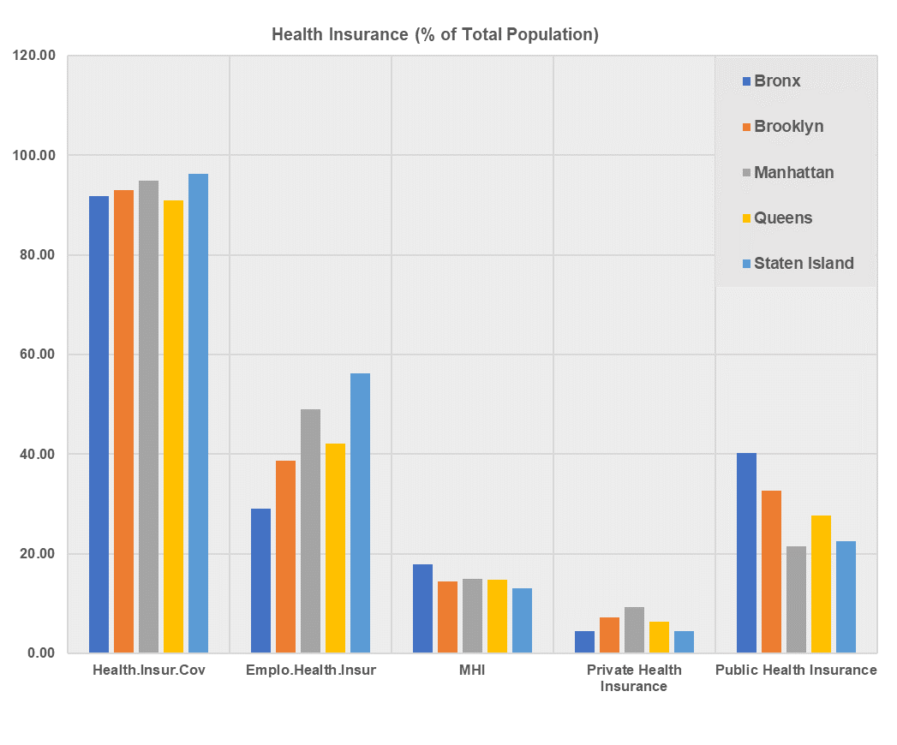
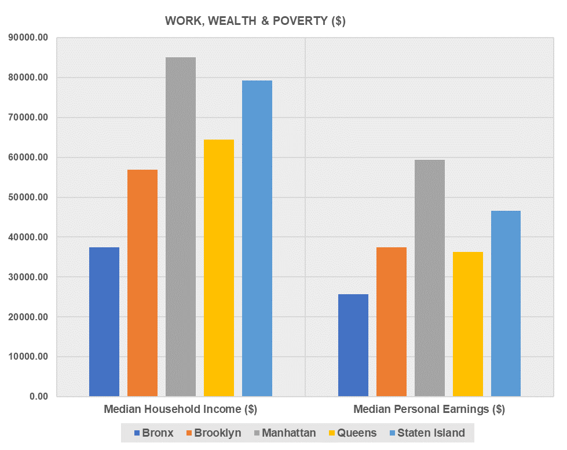

Slide 9
